Slide 1
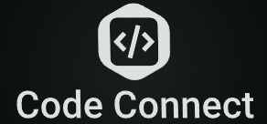
Code Connect :- A Collaborative Coding Platform
Presented By :-
Jugnu Gupta (221210056)
Kartik Mittal (221210056)
Kshitij Singh (221210061)

Slide 2
Problem Statement
Many college students face challenges in enhancing their coding skills due to:
Limited opportunities to connect with alumni for mentorship and career guidance.
Lack of access to mock interviews and real-world interview preparation tools.
Limited tools for collaborative learning, including peer-to-peer interaction and mentorship.

Slide 3
Objective/Solution
We will create a centralized platform that:
Offers a curated repository of coding problems aligned with the college curriculum.
Facilitates mentorship, peer collaboration, and alumni connections through innovative features like location-based networking.
Provides real-time coding contests, mock interviews, and gamified learning experiences.
Integrates seamlessly with popular coding platforms and career-building tools to enhance employability.

Slide 4
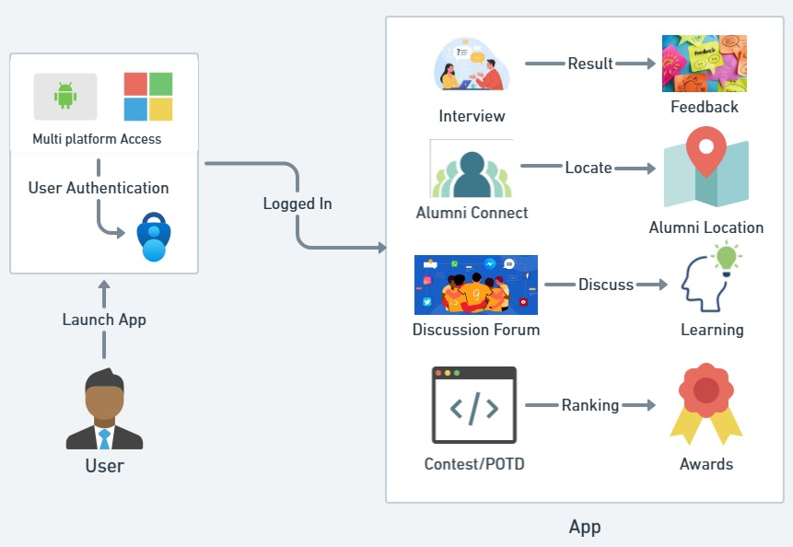
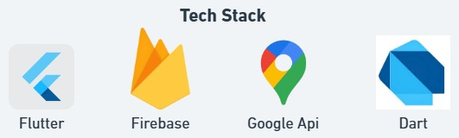
Flowchart/Tech Stack
Process Flow Architecture
Frontend : Flutter and Dart are used for building a responsive, cross-platform app. Real-time collaboration and notifications are powered by Firebase Cloud Messaging.
Backend & Database: Firebase is used for real-time data storage and user authentication. Firebase Authentication ensures secure login, while Firestore stores user data and content.
External Integrations & Security: Google API for location services. The app is secure with Firebase's built-in security rules and data encryption features.

Slide 5
Features
Problem Repository: Access a wide range of coding problems categorized by difficulty, topics.
Discussion Forums: Share and discuss solutions with peers.
Integrated Code Editor: A built-in editor with syntax highlighting, debugging tools, and support for multiple languages.
Mock Interviews: Get real-time feedback to refine your coding and problem-solving skills in a professional setting.
External Platform Integration: Sync your profile with platforms like LinkedIn, GitHub to import challenges and display progress.
Alumni Connect: Enables students to connect with alumni for mentorship, career guidance, and mock interviews, fostering a strong alumni network for professional growth.

Slide 6
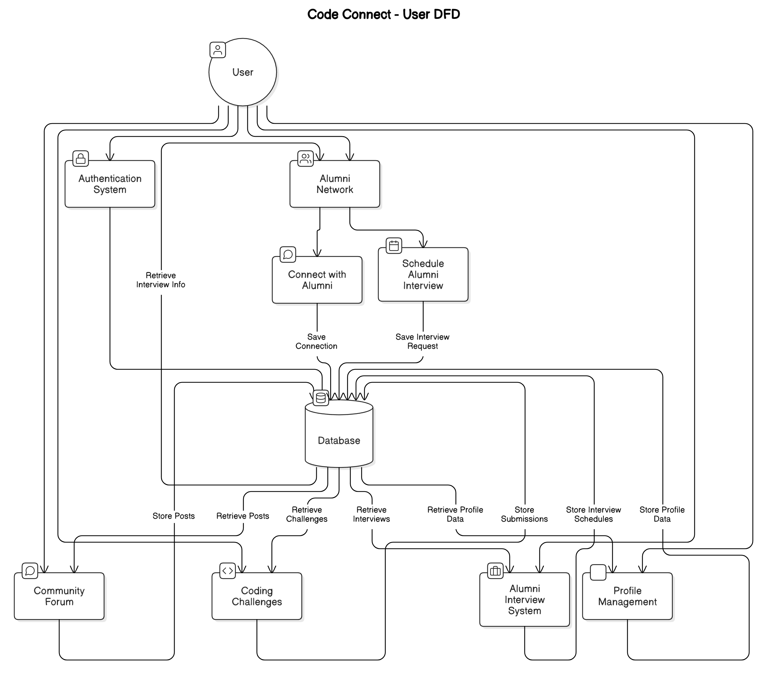
DFD -User View

Slide 7
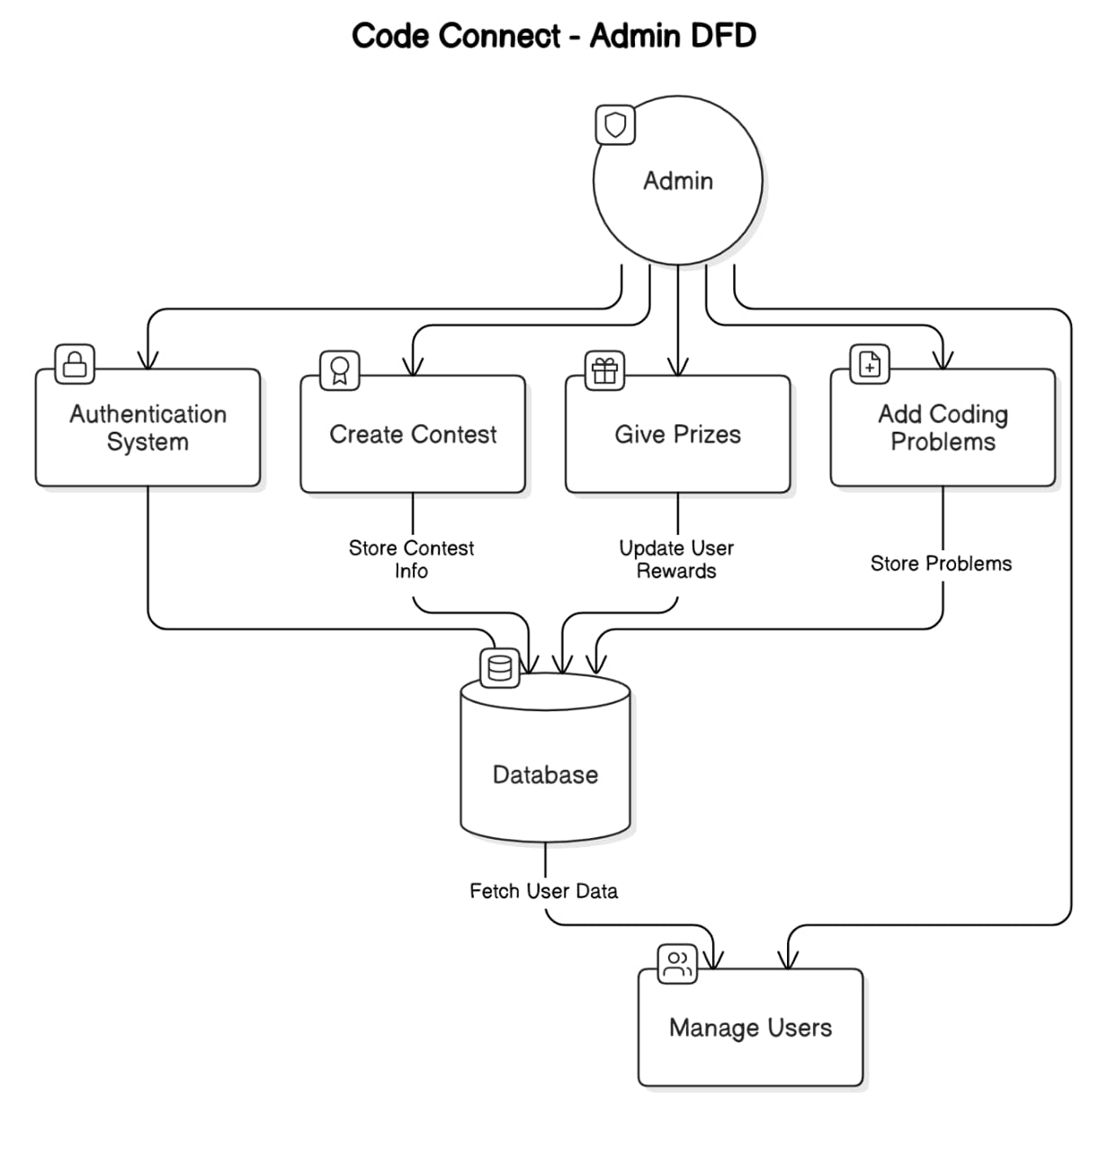
DFD -Admin View

Slide 8
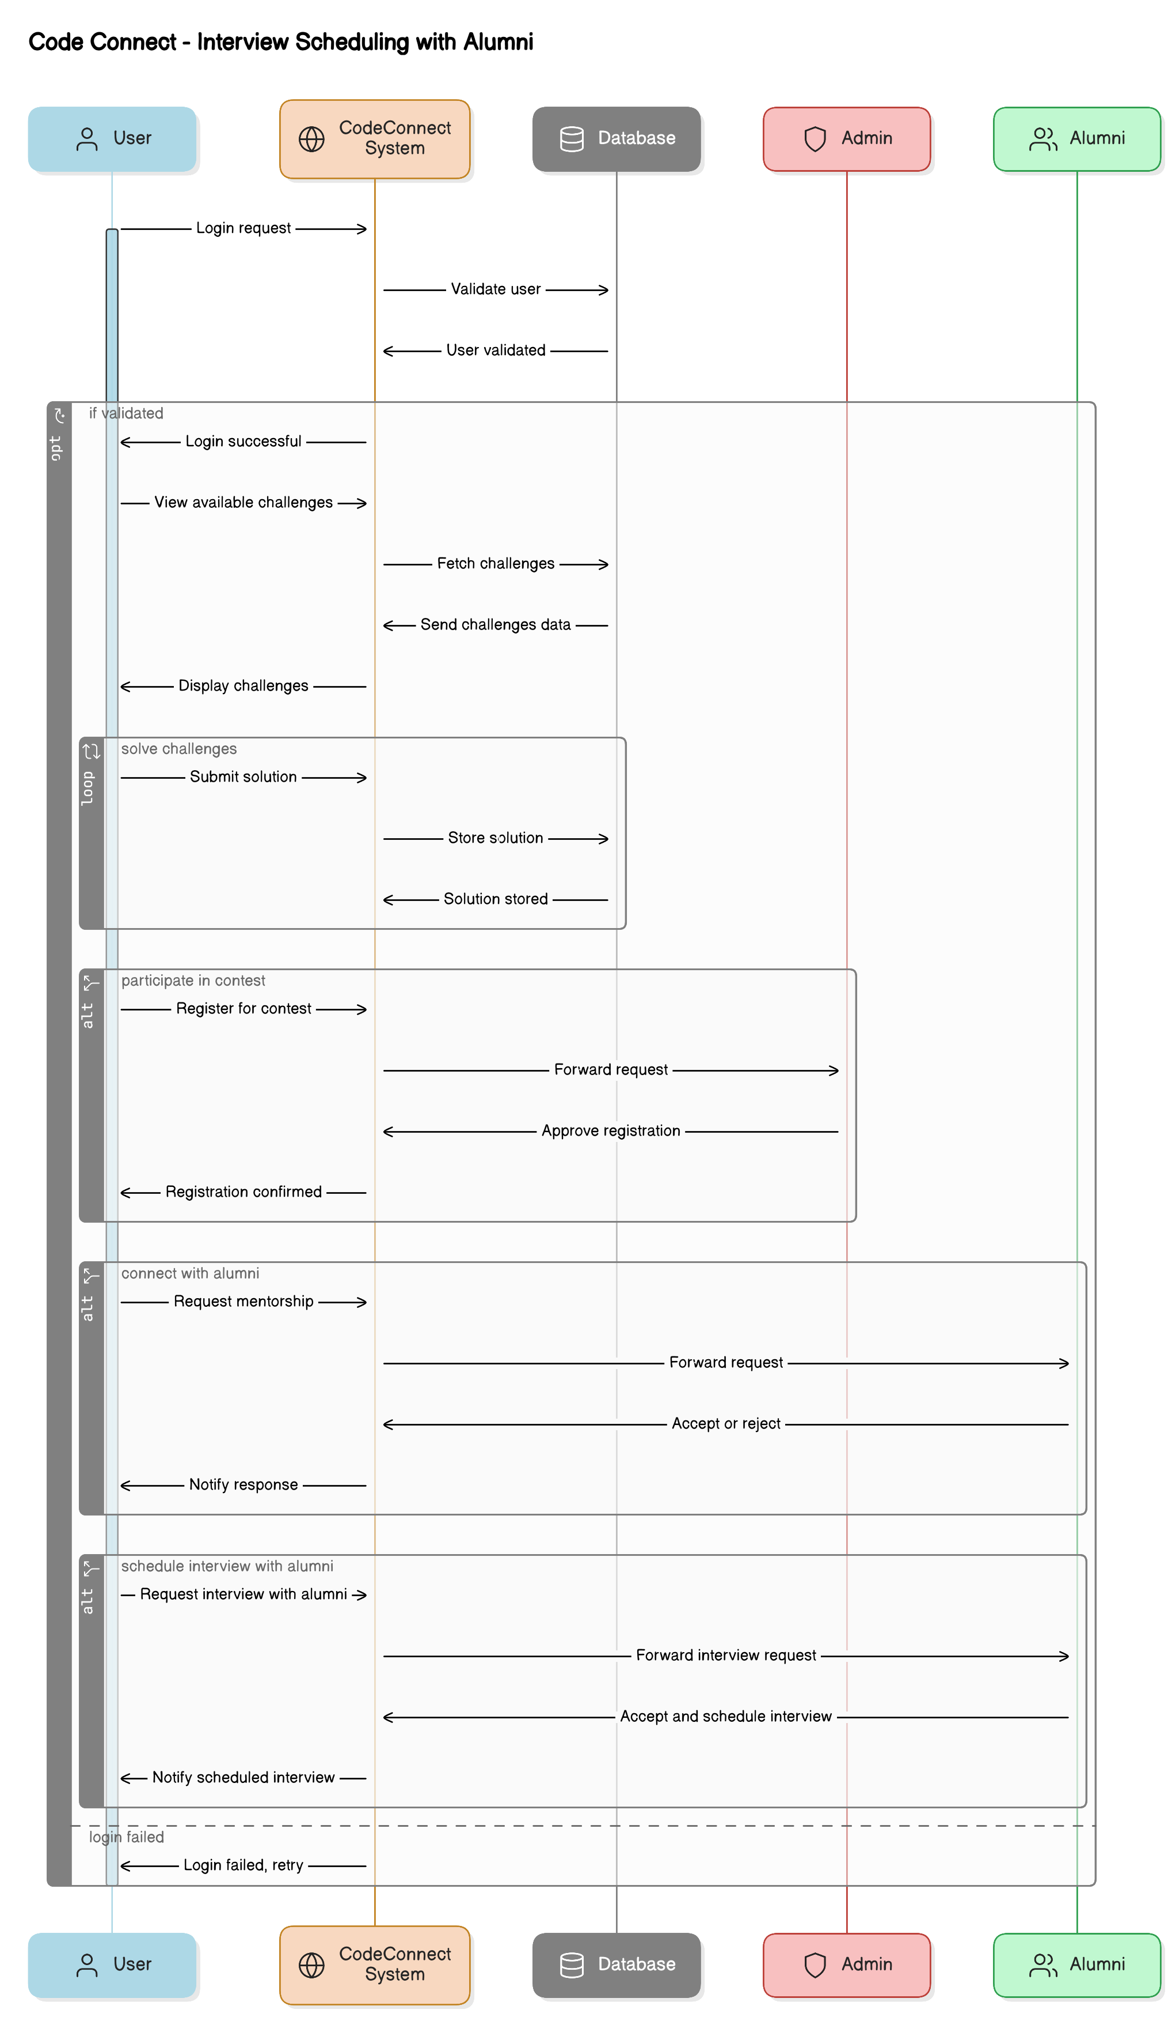
Sequential Diagram

Slide 9
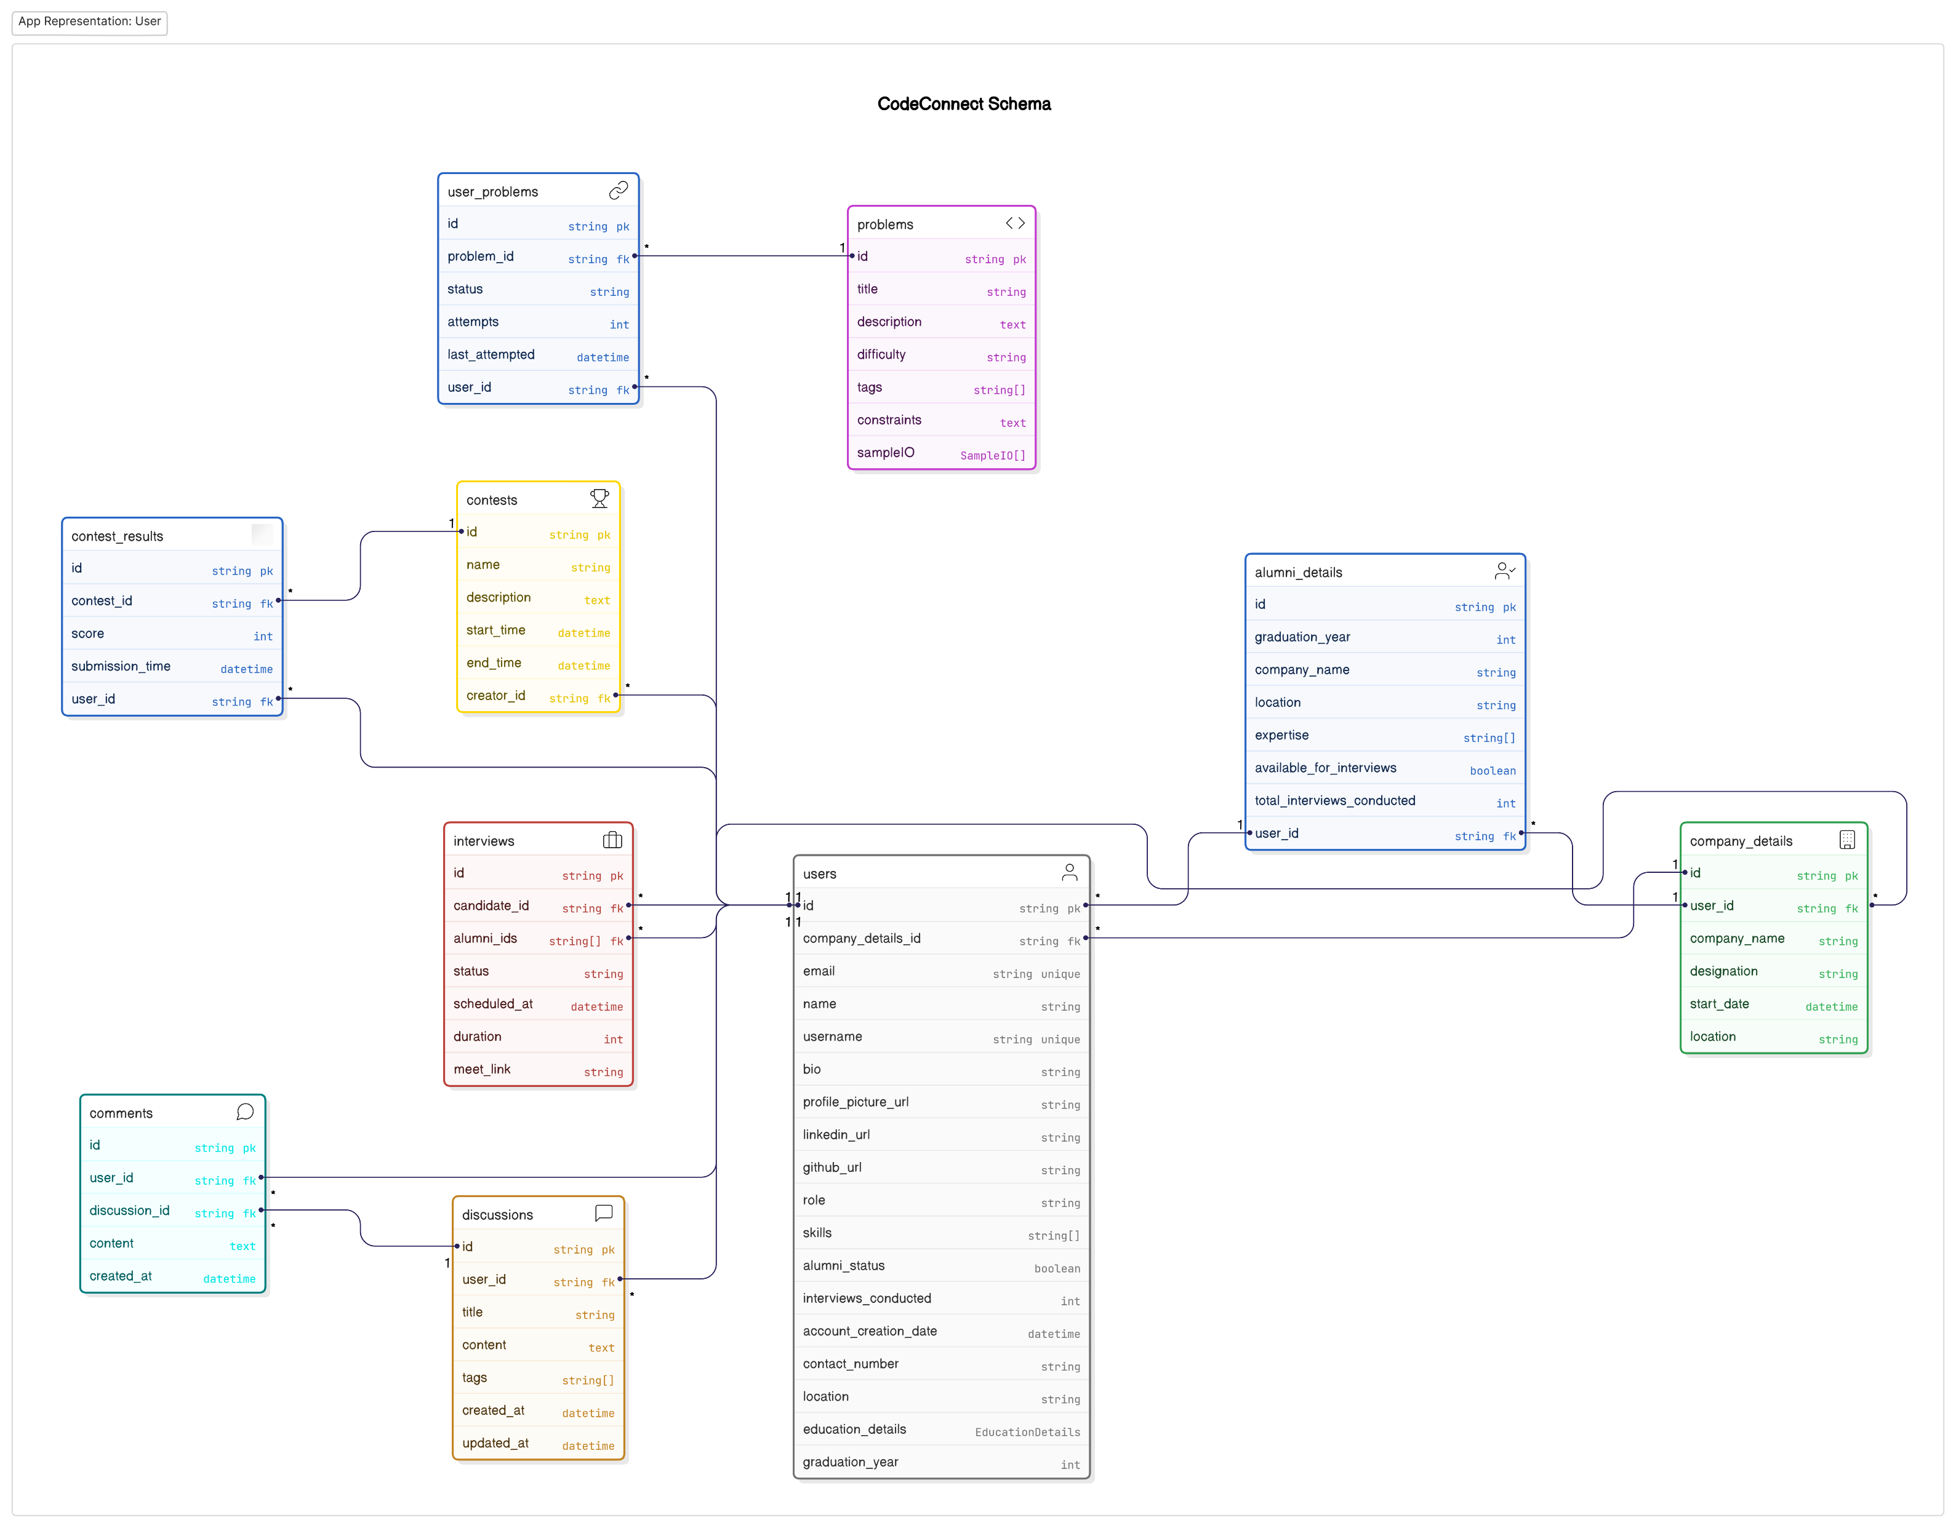
Code Connect Schema

Slide 10
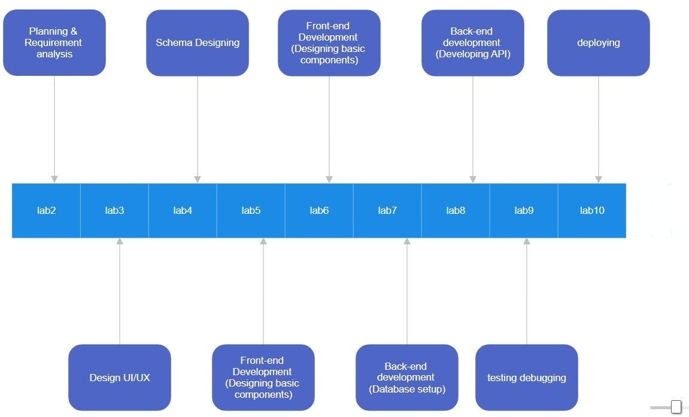
Timeline Graph
Currently we are here

Slide 11
Thank you

